Slide 1
The Analysis of Zipf’s Law
What it is, where it’s used, how it appears throughout different languages, why it’s important, and theories on why it’s everywhere
By Izzy Trejo

Slide 2
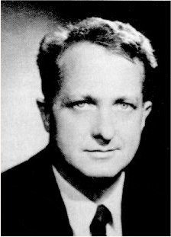
Zipf’s Law
George Kingsley Zipf was an American linguist who studied quantum linguistics. In particular, he studied statistical occurrences in different languages.. He is the eponym of Zipf’s law, which means that the law was named after him. Although he originally intended it as a model for linguistics, Zipf later generalized his law to other disciplines. In particular, he observed that the rank vs. frequency distribution of individual incomes in a unified nation approximates this law, and in his 1941 book, “National Unity and Disunity” he theorized that breaks in this “normal curve of income distribution” portend social pressure for change or revolution
George Kingsley Zipf

Slide 3
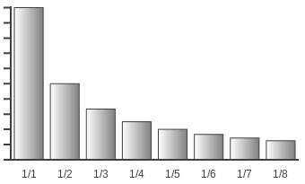
Visualization of Zipf’s Law
the odyssey
the odyssey
The second most used term is used half as much as the most frequently used term, the third most frequently used term is used a third as many times as the most frequently used term, and the ranking descends in that pattern.

Slide 4
Where does Zipf’s Law show up in real life?
(Literally everywhere)

Slide 5
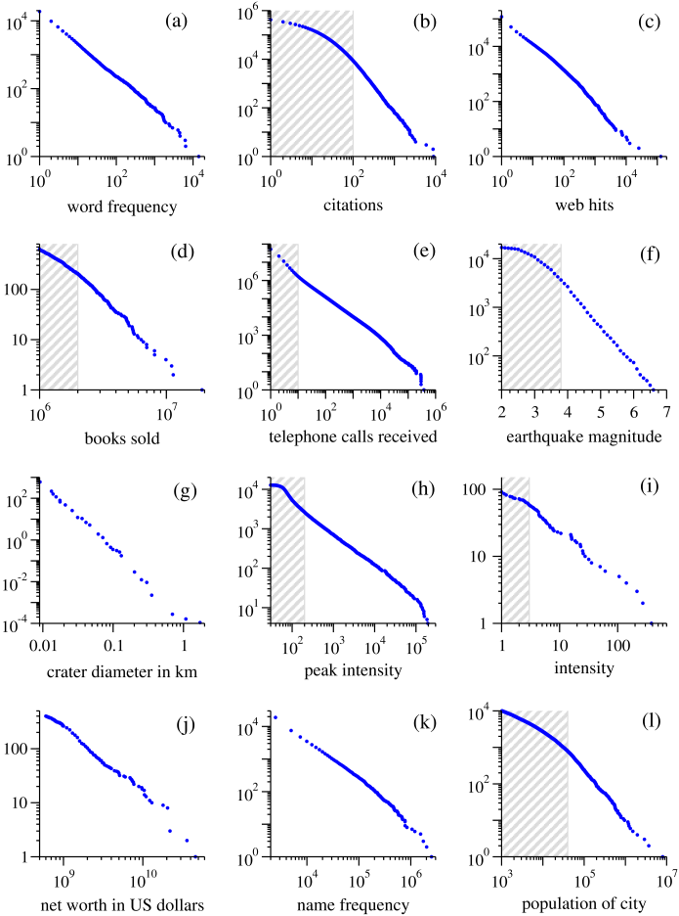
Word Frequencies
Word frequency is actually what is being analyzed in this project. Estoup observed that the frequency with which words are used follows a power law, and this observation was famously examined in depth and confirmed by Zipf. Panel (a) shows the cumulative distribution of the number of times that words occur in a typical piece of English text, in this case the text of the novel Moby Dick by Herman Melville. The most common words in this case are, in order, “the”, “of”, “and”, “a” and “to”, and the same is true for most written English texts. Interestingly, however, it is not true for spoken English. The most common words in spoken English are, in order, “I”, “and”, “the”, “to” and “that”.
J. B. Estoup, Gammes Stenographiques. Institut Stenographique de France, Paris made an observation on this before Zipf did, yet the law was still named after Zipf.

Slide 6
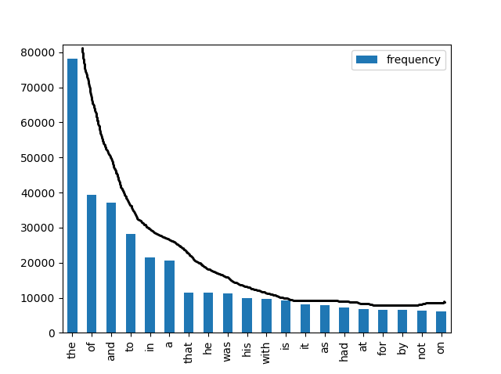
The Adventures of Sherlock Holmes

Slide 7
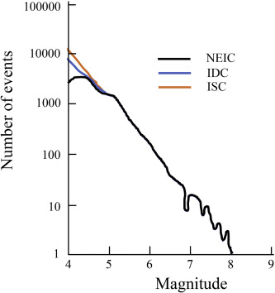
Earthquake Magnitudes
Frequency number size distribution drawn based on data from three international centers: ISC (International Seismological Center), IDC (International Data Center), and NEIC (National Earthquake Information Center)
Magnitude of earthquakes in California between January 1910 and May 1992. Magnitude is proportional to the logarithm of the maximum amplitude of the earthquake,

Slide 8
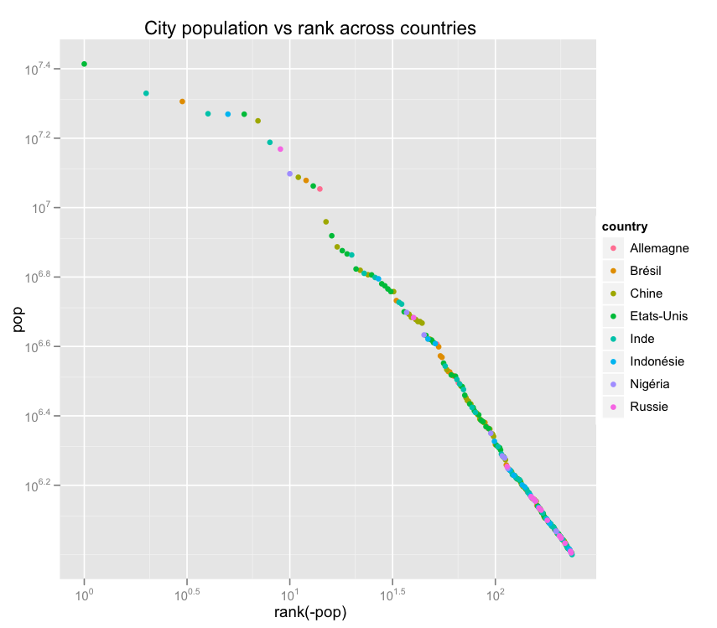
City Populations
“If you fit a power law you can use rank to predict the sizes of smaller cities very accurately, according to Will’s analysis....The answer is usually, yes, the power law looks like it holds within countries as well.”
Populations of cities: Cumulative distribution of the size of the human populations of US cities as recorded by the US Census Bureau in 2000.

Slide 9
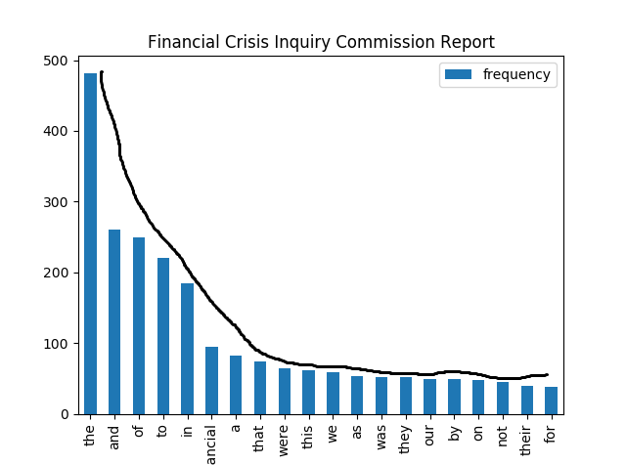
Financial Crisis Inquiry Commission Report
The Financial Crisis Inquiry Report: Final Report of the National Commission on the Causes of the Financial and Economic Crisis in the United States

Slide 10
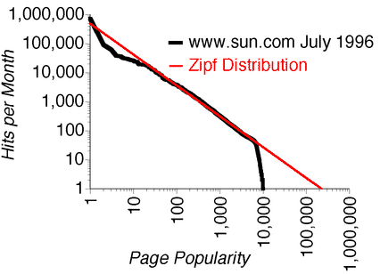
Popularity of Websites
Lada and Adamic, Lada and Huberman, Bernardo A., The Nature of Markets in the World Wide Web (May 6, 1999).
World Leaders in Research-Based User Experience
Web hits: The cumulative distribution of the number of clicks received by web sites (servers, not pages) during a single day from a subset of the users of the AOL Internet service. The site with the most hits, by a long shot, was yahoo.com.
Comparing empirical log data from Sun’s website with a theoretical Zipf distribution. This graph uses a double logarithmic scale. The figure shows incoming page-requests to a single website. (Jakob Nielsen, 1997)

Slide 11
The Distribution of Wealth in the U.S.
Aggregate net worth in dollars of the richest individuals in the US in October 2003. The cumulative distribution of the total wealth of the richest people in the United States. Wealth is defined as aggregate net worth. For instance, when the data was compiled in 2003, America’s richest person, William H. Gates III, had an aggregate net worth of $46 billion, much of it in the form of stocks of the company he founded, Microsoft Corporation. Note that net worth does not actually correspond to the amount of money individuals could spend if they wanted to: if Bill Gates were to sell all his Microsoft stock, for instance, or otherwise divest himself of any significant portion of it, it would certainly depress the stock price. The data is from Forbes magazine, 6 October 2003.

Slide 12
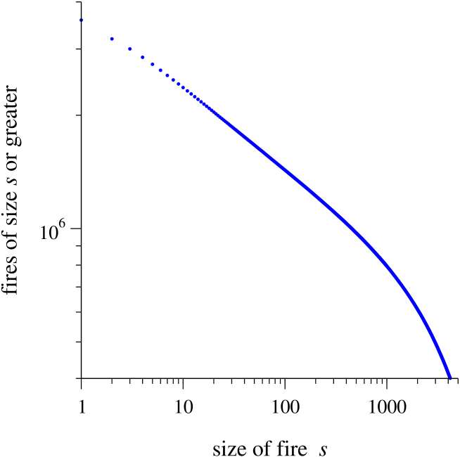
Patterns of Wildfires
“As first proposed by Bak et al. It is possible that some dynamical systems actually arrange themselves so that they always sit at the critical point, no matter what state we start off in. One says that such systems self-organize to the critical point, or that they display self-organized criticality. A now-classic example of such a system is the forest fire model of Drossel and Schwabl, which is based on the percolation model we have already seen. if we wait long enough, we expect the forest fire model to self-organize to a state in which it has a power-law distribution of the sizes of clusters, or of the sizes of fires.” (B. Drossel and F. Schwabl 1992)

Slide 13
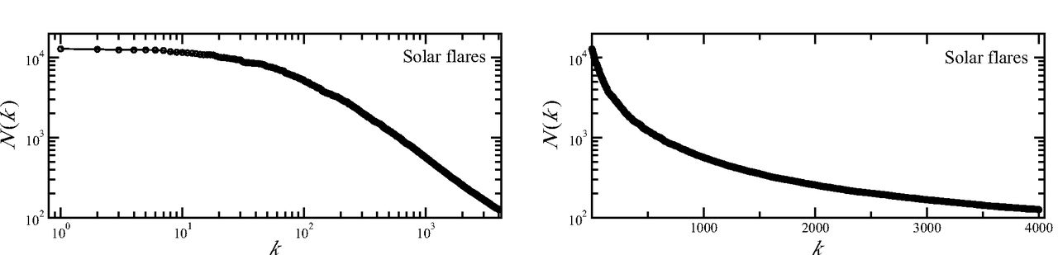
Solar Flares
Intensity of solar flares: The cumulative distribution of the peak gamma-ray intensity of solar flares. The observations were made between 1980 and 1989 by the instrument known as the Hard X-Ray Burst Spectrometer aboard the Solar Maximum Mission satellite launched in 1980. The spectrometer used a CsI scintillation detector to measure gamma-rays from solar flares and the horizontal axis in the figure is calibrated in terms of scintillation counts per second from this detector. The data is from the NASA Goddard Space Flight Center, umbra.nascom.nasa.gov/smm/hxrbs.html. See also Lu and Hamilton.

Slide 14
Amount of soldiers who die in war
D. C. Roberts and D. L. Turcotte, Fractality and self-organized criticality of wars. (1998). M. Small and J. D. Singer, Resort to Arms: International and Civil Wars, 1816-1980. Sage Publications, Beverley Hills (1982).
Intensity of wars: The cumulative distribution of the intensity of 119 wars from 1816 to 1980. Intensity is defined by taking the number of battle deaths among all participant countries in a war, dividing by the total combined populations of the countries and multiplying by 10000. For instance, the intensities of the First and Second World Wars were 141.5 and 106.3 battle deaths per 10000 respectively. The worst war of the period covered was the small but horrifically destructive Paraguay-Bolivia war of 1932–1935 with an intensity of 382.4. The data are from Small and Singer. See also Roberts and Turcotte.

Slide 15
Phone Calls People Receive
Telephone calls: The cumulative distribution of the number of calls received on a single day by 51 million users of AT&T long distance telephone service in the United States. After Aiello et al. . The largest number of calls received by a customer in that day was 375746, or about 260 calls a minute (obviously to a telephone number that has many people manning the phones). Similar distributions are seen for the number of calls placed by users and also for the numbers of email messages that people send and receive
A Random Graph Model for Massive Graphs: http://digg.cs.tufts.edu/readings/pdf/001.pdf
Scale-free topology of e-mail networks: https://www.arxiv-vanity.com/papers/cond-mat/0201476/
Information Dynamics in the Networked World: https://www.arxiv-vanity.com/papers/cond-mat/0308321/

Slide 16
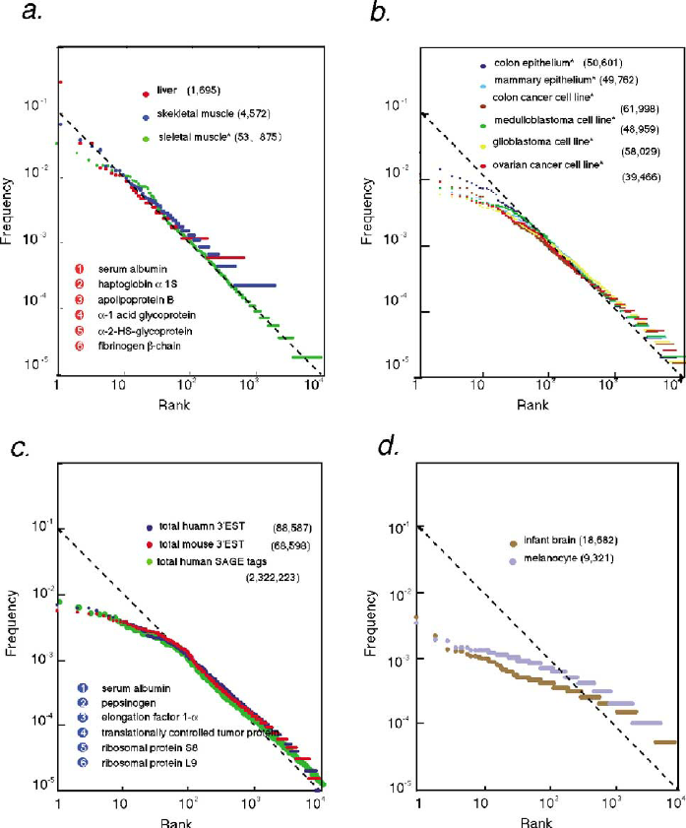
Human Transcriptomes (whatever those are)
Log frequency log rank plot of transcriptome data. The frequency of occurrence (f ) of each transcript in 3 EST and SAGE tag collections representing various transcriptomes were plotted against the abundance rank (r) .
Zipf's law and human transcriptomes: An explanation with an evolutionary model - Scientific Figure on ResearchGate. https://www.researchgate.net/figure/Log-frequency-log-rank-plot-Zipfs-plot-of-transcriptome-data-The-frequency-of_fig1_8902669 [accessed 2 Aug, 2022]

Slide 17
The Immune System: Zipf-scaling behavior in the immune system
Abstract: The Zipf law, an approach to analyzing linguistic texts, was applied to study the Cytotoxic T Lymphocytes (CTL) repertoire, one of the major components of the immune system. A Zipf-scaling behavior was observed in those CTL repertoires obtained in normal or conventional mice. In contrast, CTL repertoires from irradiated chimeric animals, showed a non-scaling statistical behavior when tested by the Zipf analysis,suggesting that normal repertoires work like a structured biological language. The fractal dimension (D) was derived from the Zipf plots, and correlates well with the nature of the repertoires: high, D > 0.8, in conventional mice. Non-fractal, D > 1, in chimeric animals, and low, D < 0.3, in athymic mice. Then, D seems to be an useful tool to characterize the current status of the immune system.
Burgos JD, Moreno-Tovar P. Zipf-scaling behavior in the immune system. Biosystems. 1996;39(3):227-32. doi: 10.1016/0303-2647(96)01618-8. PMID: 8894123.

Slide 18
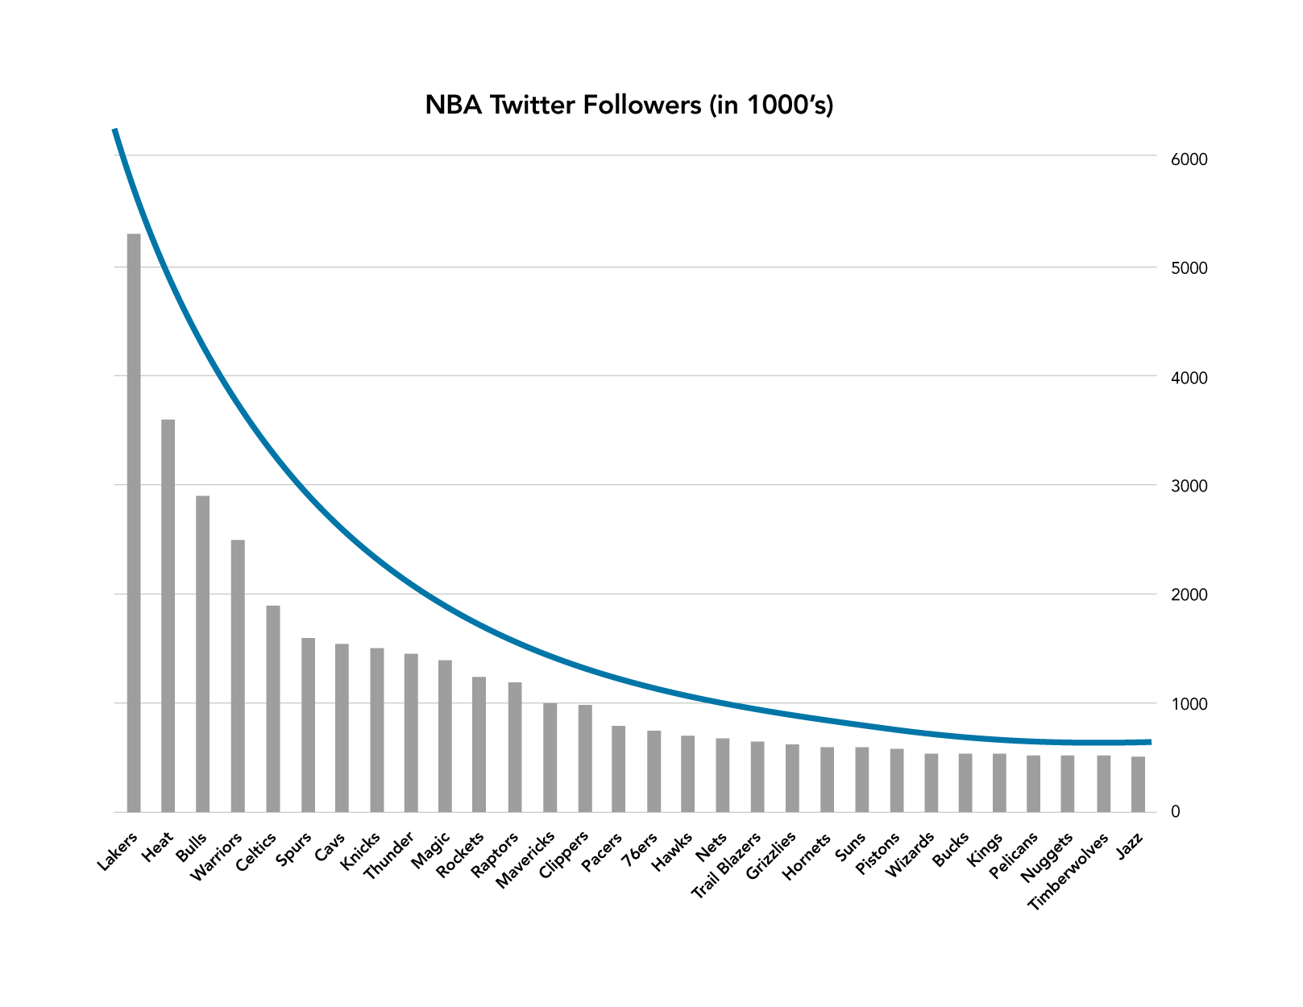
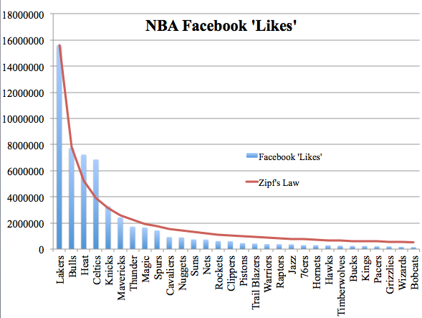
The NBA??!!
Even the number of Twitter followers for NBA teams follows Zipf’s law. Zipf’s Law and Your Lenders (Wells, Dallas 2020)

Slide 19
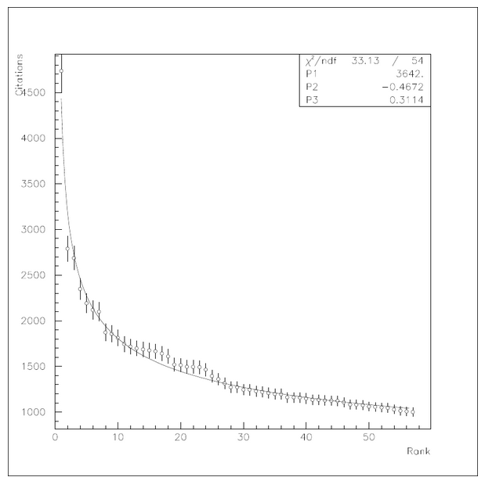
Number of times an Academic Paper is Cited
“A curious observation was made that the rank statistics of scientific citation numbers follows Zipf-Mandelbrot’s law. The same pow-like behavior is exhibited by some simple random citation models. The observed regularity indicates not so much the peculiar character of the underlying process, but more likely, than it is usually assumed, its more stochastic nature.
As first observed by Price, the numbers of citations received by scientific papers appear to have a power-law distribution. The data in panel (b) are taken from the Science Citation Index, as collated by Redner, and are for papers published in 1981. The plot shows the cumulative distribution of the number of citations received by a paper between publication and June 1997.

Slide 20
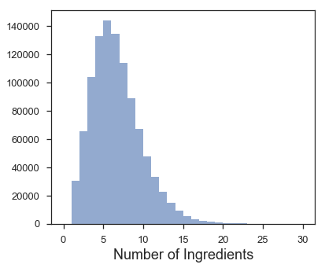
Ingredients used in a Cookbook
The MIT dataset from (Recipe1M+: A Dataset for Learning Cross-Modal Embeddings for Cooking Recipes and Food Images by Marin, Javier and Biswas, Aritro and Ofli, Ferda and Hynes, Nicholas and Salvador, Amaia and Aytar, Yusuf and Weber, Ingmar and Torralba, Antonio, 2019) It contains 1+ million recipes, including lists of ingredients. That’s what we are looking for. I restricted each list to contain only elements appearing in the other dataset, to be able to compare results later. Here is the distribution of the final number of ingredients per recipe

Slide 21
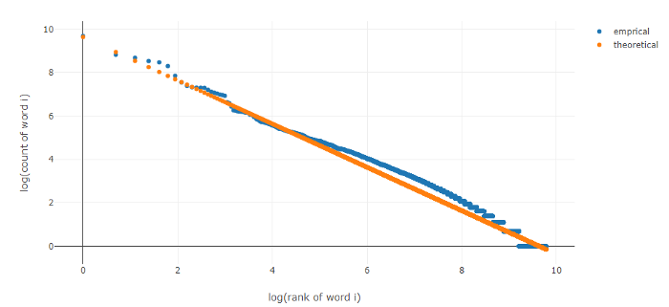
The Firing Patterns of Neural Networks
https://medium.com/@_init_/using-zipfs-law-to-improve-neural-language-models-4c3d66e6d2f6

Slide 22
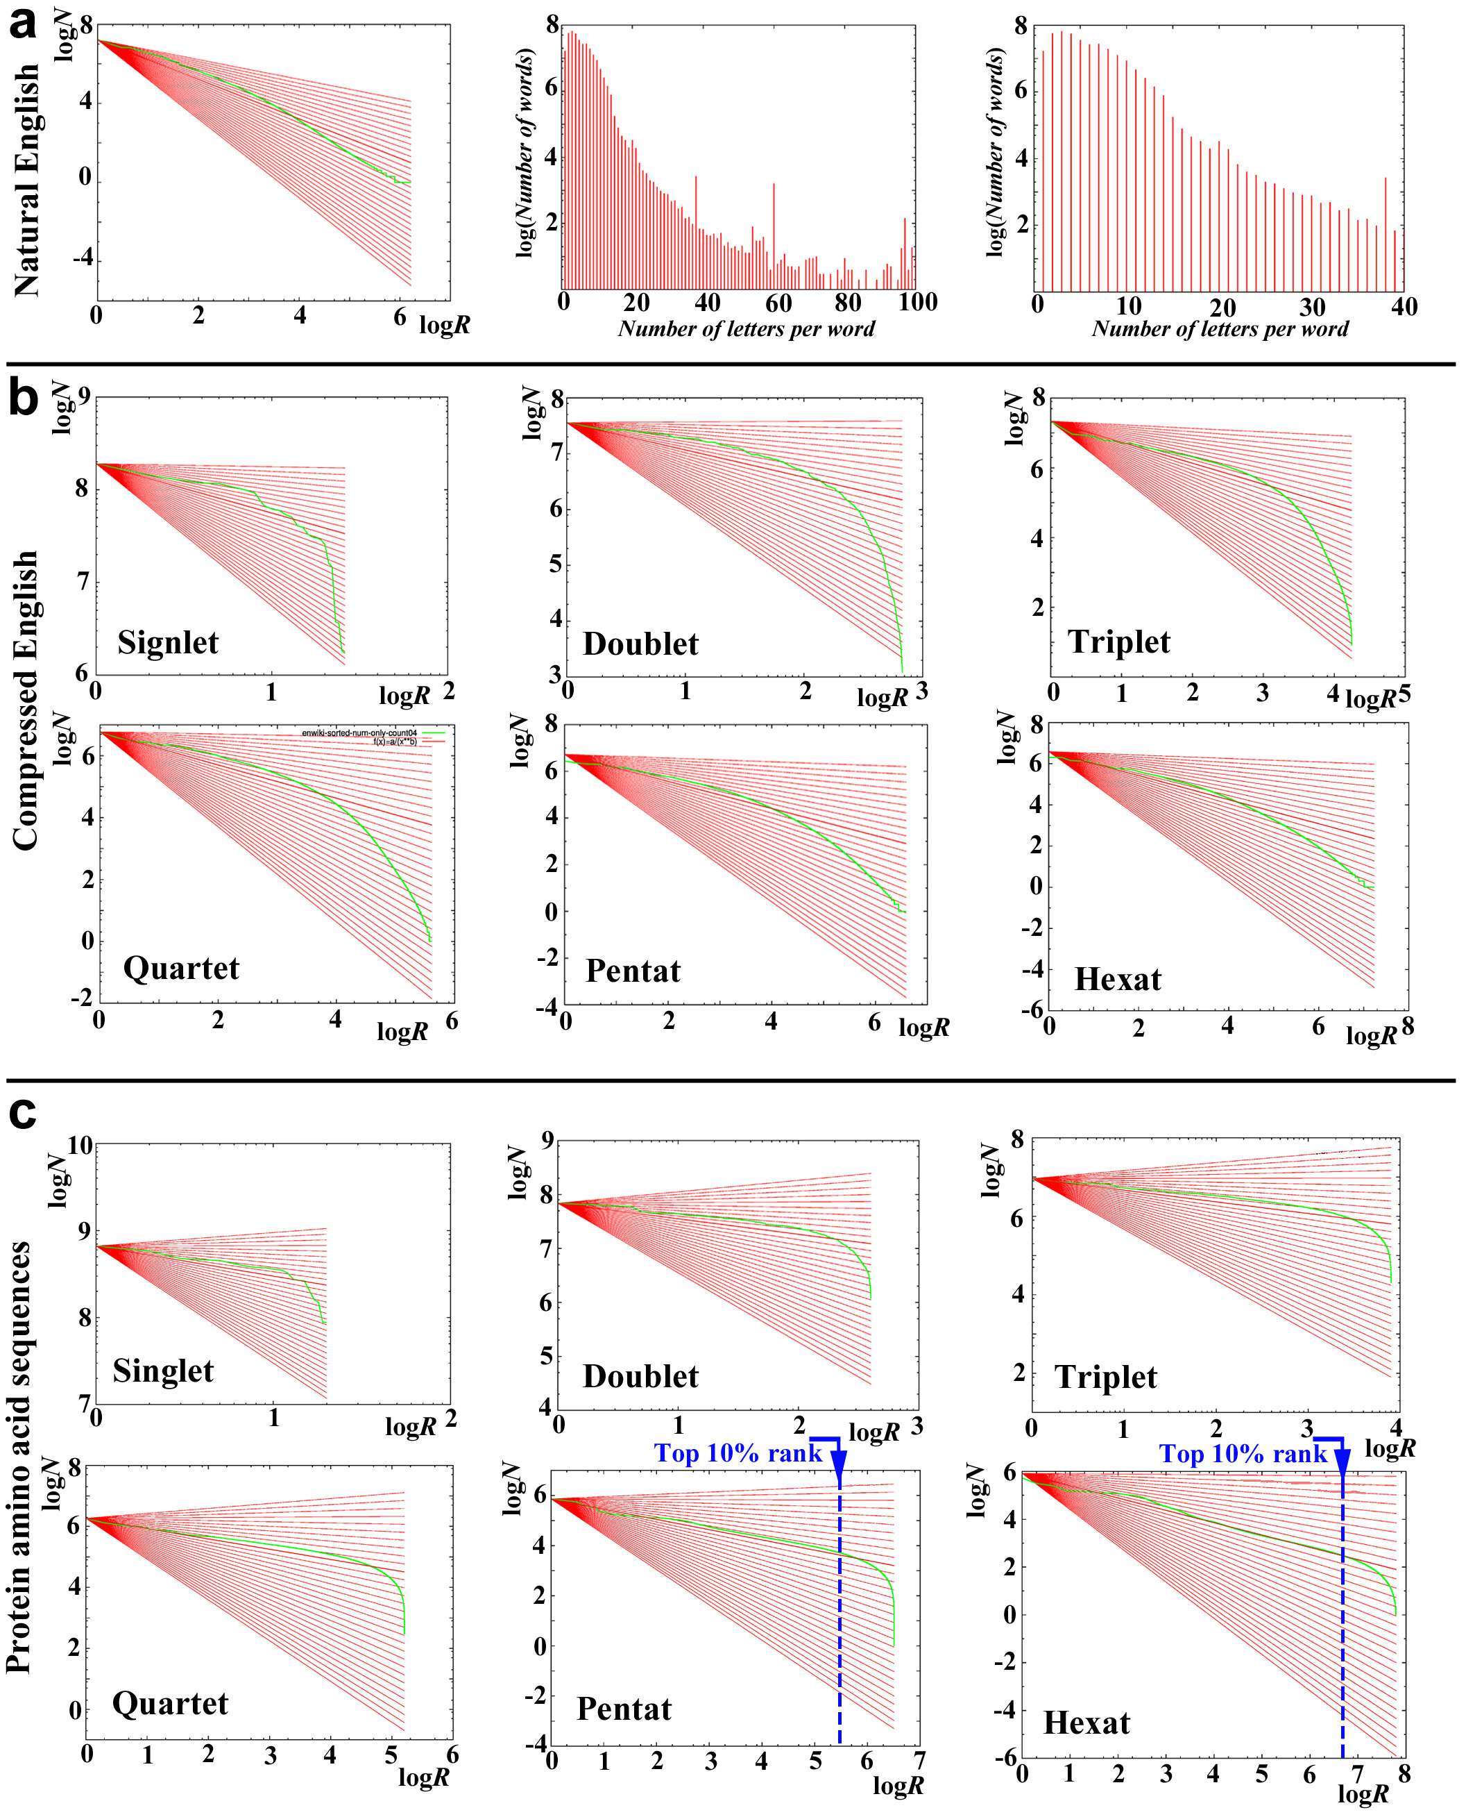
Protein Sequences
Word Decoding of Protein Amino Acid Sequences with Availability Analysis: A Linguistic Approach
https://journals.plos.org/plosone/article/figure?id=10.1371/journal.pone.0050039.g001

Slide 23
Diameter of Moon Craters
Diameter of moon craters: The cumulative distribution of the diameter of moon craters. Rather than measuring the number of craters of a given size on the whole surface of the moon, the vertical axis is normalized to measure number of craters per square kilometer, which is why the axis goes below 1, unlike the rest of the plots, since it is entirely possible for there to be less than one crater of a given size per square kilometer.
Neukum and B. A. Ivanov, Crater size distributions and impact probabilities on Earth from lunar, terrestial-planet, and asteroid cratering data. In T. Gehrels (ed.), Hazards Due to Comets and Asteroids, pp. 359–416, University of Arizona Press, Tucson, AZ (1994).

Slide 24
Popularity of Last Names
Frequency of occurrence of family names in the US in the year 1990.Frequencies of family names: Cumulative distribution of the frequency of occurrence in the US of the 89000 most common family names, as recorded by the US Census Bureau in 1990. Similar distributions are observed for names in some other cultures as well (for example in Japan) but not in all cases. Korean family names for instance appear to have an exponential distribution.
Power-law Distribution of Family Names in Japanese Societies: https://www.arxiv-vanity.com/papers/cond-mat/9912035/
Distribution of Korean Family Names: https://www.arxiv-vanity.com/papers/cond-mat/0407311/

Slide 25
Copies of Books Sold
Copies of books sold: The cumulative distribution of the total number of copies sold in America of the 633 bestselling books that sold 2 million or more copies between 1895 and 1965. The data were compiled painstakingly over a period of several decades by Alice Hackett, an editor at Publisher’s Weekly. The best selling book during the period covered was Benjamin Spock’s The Common Sense Book of Baby and Child Care. (The Bible, which certainly sold more copies, is not really a single book, but exists in many different translations, versions and publications, and was excluded by Hackett from her statistics.) Substantially better data on book sales than Hackett’s are now available from operations such as Nielsen BookScan, but unfortunately at a price this author cannot afford. I should be very interested to see a plot of sales figures from such a modern source.
P. Hackett, 70 Years of Best Sellers, 1895-1965. R. R. Bowker Company, New York, NY (1967).

Slide 26
Okay, you get the idea

Slide 27
The Project
The idea for this project is to create a frequency distribution calculator to analyze for Zipf’s law in different translations of text to see how it varies within different languages. Zipf’s law is just seeing the distribution of terms. It was simple really, all I had to do was find an ancient book that is translated in 5 different languages, remember how to code, code a frequency distribution calculator, input the text, parse the text, figure out what a github repo is, receive my results, try to visualize my results somehow, have a couple mental breakdowns, and contemplate my sanity.

Slide 28
Overview
Zipf's law is an equation that demonstrates the frequency distribution of terms. Zipf's law states that a term is inversely proportional to its ranking. This means the second most used term is used half as much as the most frequently used term, the third most frequenlty used term is used a third as many times as the most frequently used term, and the ranking decends in that patern. Zipf's law for distribution is seen everywhere, from the population of cities, the number of academic papers cited, the number of people that die in war, and even in language. the occurrence of Zipf's law in language is a peculiar phenomenon. The goal of this project is to dig deeper into the way Zipf's law plays out in various languages, and to propose a few answers to why it occurrs. In order to analyze for Zipf's law, I made a frequency distribution calculator. The distribution calculator parsed, and tokenized words in order to visualize them on a graph. There was a strong focus on not just how Zipf's law applied in the English language, but in others as well. After finding copies of the same books that had been translated in English, Spanish, Greek, Latin, and French, the calculator was built. Upon further analysis, it was found that Zipf's law holds the same in all of the languages listed above. Zipf's law knows no language boundary when it comes to the distribution of terms. The main finding was that the word "the" was the most commonly used word in all data sets. The second finding was that Zipf's law does not aide in summarizing the contents of a book based on the most commonly used terms. It could be presumed that one could sumarize a book if given the most commonly used words, but, besides the names of characters, little context is provided for the actual contenents of the book. Finally, I researched the reason why Zipf's law occurs everywhere in nature. The reason why Zipf's law is seen in mathematics, language, and conversations with friends is because of Mandelbort's theory of randomness, preferential attachment, critical points, and the principle of least effort. Zipf's law is an incredibly interesting phenomenon that can be seen everywhere, but aside from where and why it happens, the most important question is: Why do we care about Zipf's law? What good does it do for real life implementation. In order to analyze Zipf’s law of frequency distribution, I had to program a word frequency calculator.

Slide 29
Steps
Create a frequency distribution calculator
Find Text
Parse Text
Run frequency analysis
Visualize results
Write a paper
Create a presentation

Slide 30
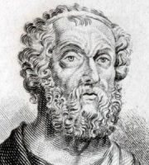
The Data set
I would like to thank my saving grace, the project Gutenberg library. These angels had open source, and un-copyrighted text that can be used by anyone. The only books they have though, are rather old, but that would not be a problem. I just had to find a book that had copies in multiple languages. The Odyssey and The Iliad boasted the most impressive translations of text. I was able to acquire the sequel in English, Spanish, French, Latin, and Greek. This was a good data set to work with. Thanks Homer, love ya.

Slide 31
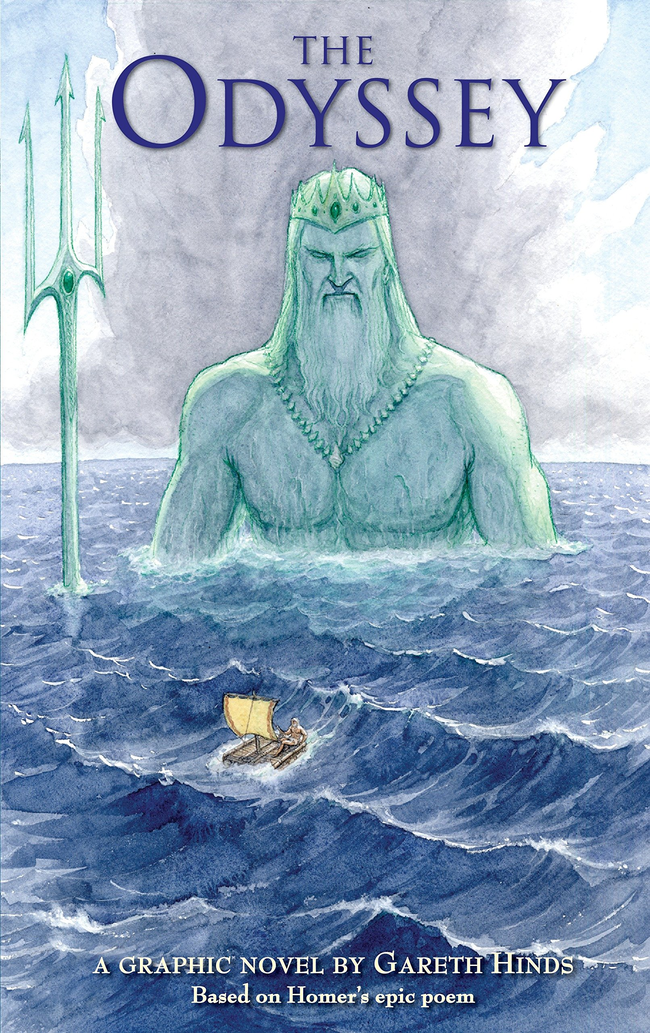
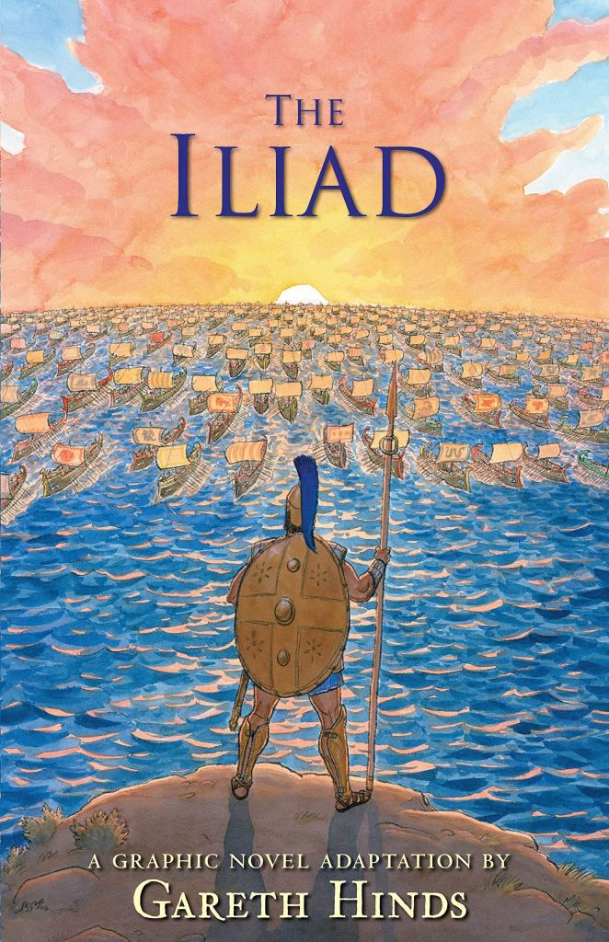
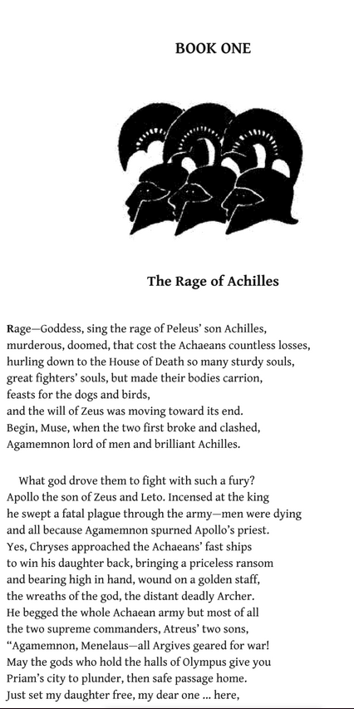
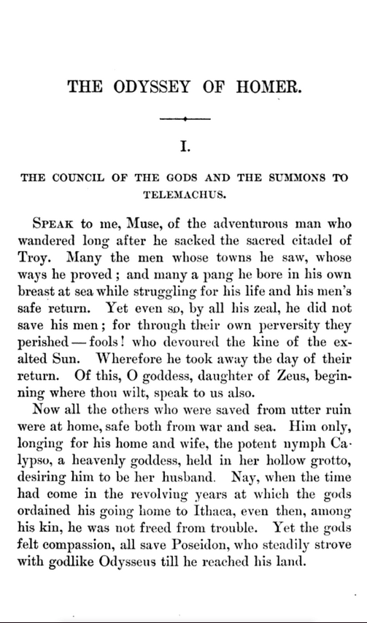
Find Text

Slide 32
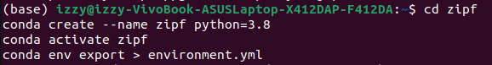
Create a Frequency Distribution Calculator
Use cookie cutter to create a copy of my Zipf repository
2. Use zipf, zipf, and zipf as the answers to the first 3 questions, and “Zipf’s law project” as the description. Then proceed to create an environment and save it:

Slide 33
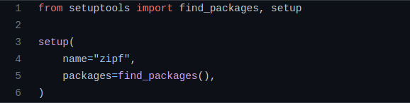
Setup

Slide 34
Parsing Text
Parsing text is the cleaning of text, so it may be further analyzed. Researchers do this in order to remove any extra items that are not needed in the data set they are analyzing. The way text would be parsed was by removing the footer, the header, and punctuation. Each book in the Gutenberg library has a header and footer that state where the book started and ended. Knowing where the header ended and the footer started was useful, because I needed to know where to cut it out. After the header and footer have been removed, punctuation is next. In this project, punctuation is not being analyzed, so it does no good to this particular data set. Once punctuation is removed, I tokenized by words. tokenizing by words would select all words without their strings. Once words have been tokenized, the next step is running the analysis.

Slide 35
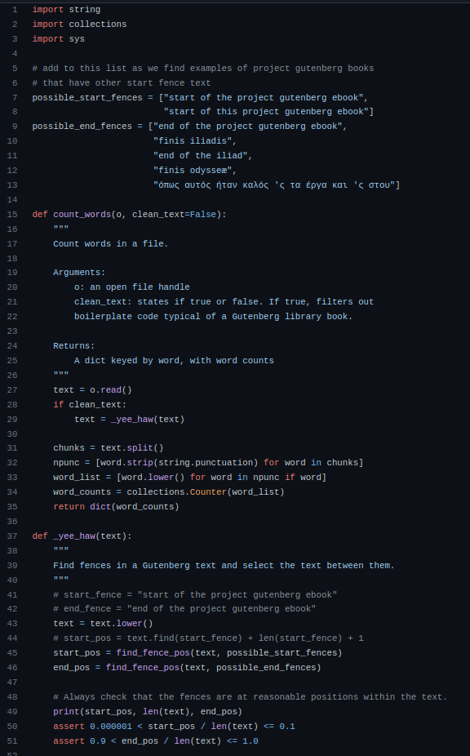

Parsing Text

Slide 36
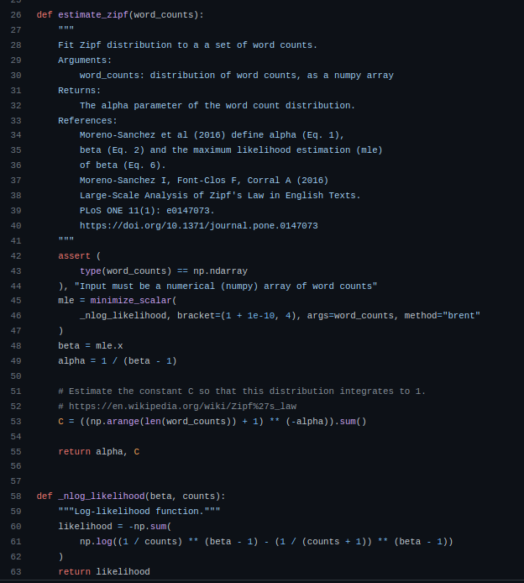
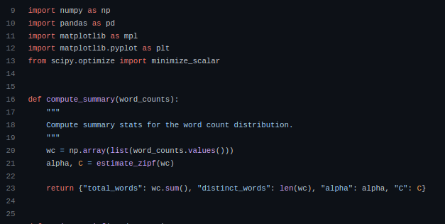
Fit Distribution
A lot of this code was inspired by merely-useful on github. Their code can be found in https://github.com/merely-useful/py-rse/blob/book/zipf/bin/plotcounts.py
authors.

Slide 37
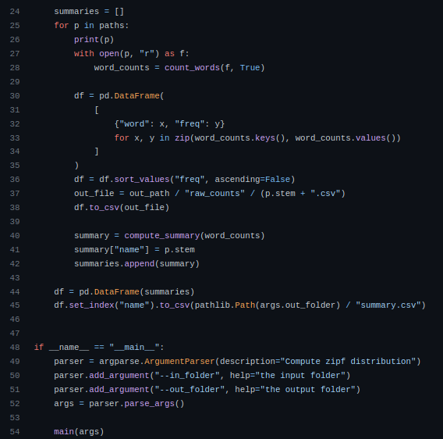
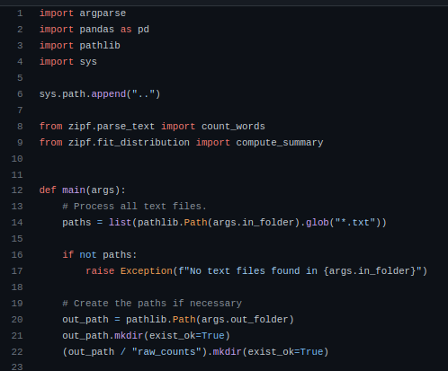
Run Analysis

Slide 38
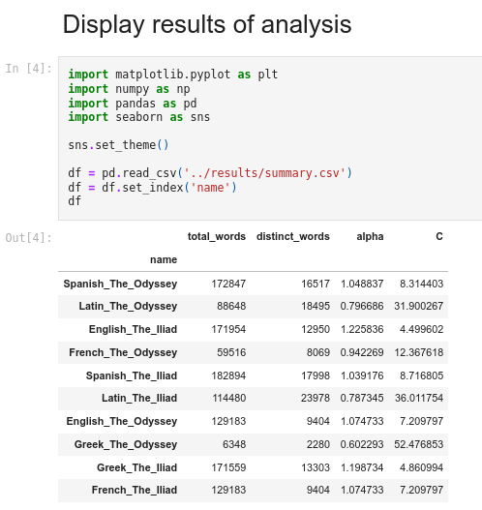
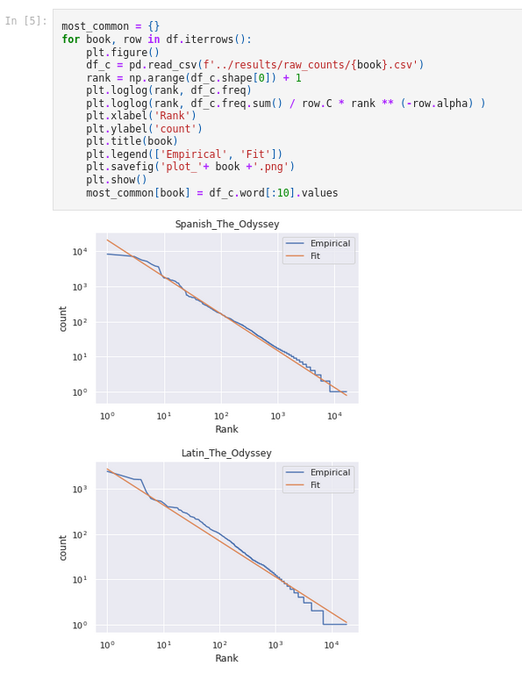
Visualizing Results
Input:
Input:
Output:
Output on next slide...

Slide 39
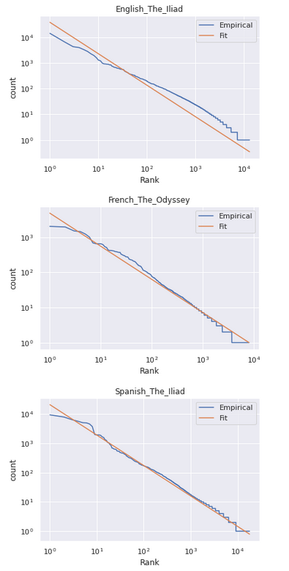
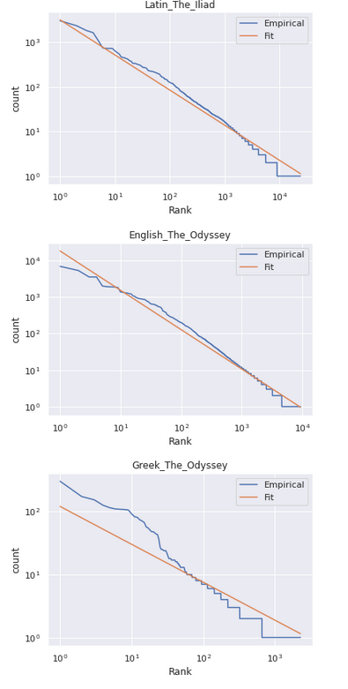
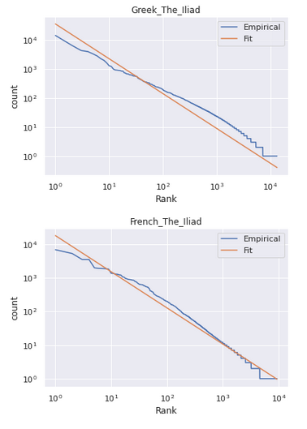
Visualizing Results
Output:

Slide 40
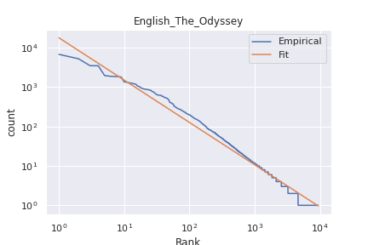
English Odyssey

Slide 41
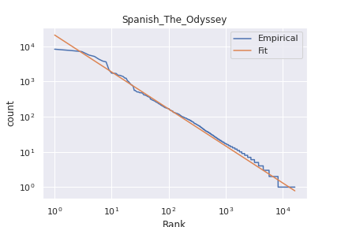
Spanish Odyssey

Slide 42

French Odyssey

Slide 43
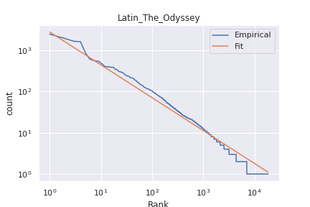
Latin Odyssey

Slide 44
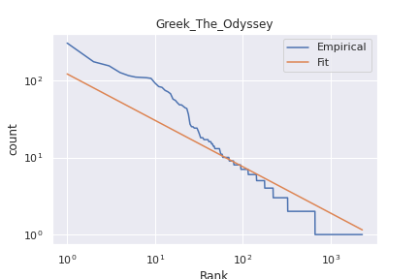
Greek Odyssey

Slide 45
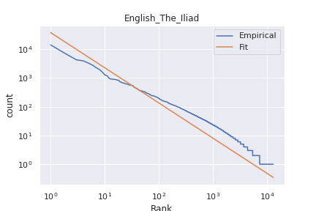
English Iliad

Slide 46
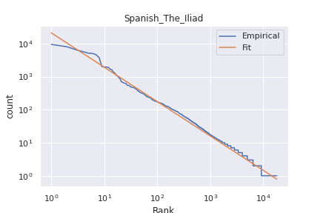
Spanish Iliad

Slide 47
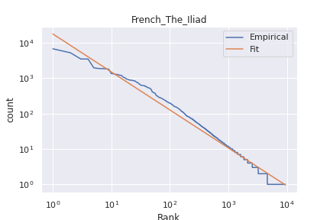
French Iliad

Slide 48
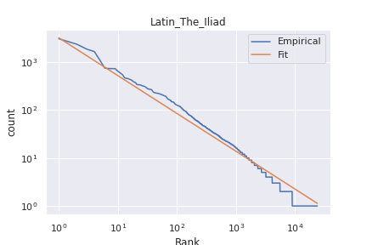
Latin Iliad

Slide 49

Greek Iliad

Slide 50
Results
As seen in the graphs above, Zipf’s law does not vary within languages. Something about the way books are written transcends language boundaries. All languages apply to Zipf’s law, because there is no escaping this distribution in nature. Repetitive vocabulary is engrained into human language. The reason why this happens is a combination of {go to your notes}. fter analyzing translations of The Odyssey and The Iliad in Latin, English, French, Spanish, and Greek, there have been a few conclusions that can be drawn jsut upon looking at the graphs. The most obvious result to note is that all the graphs look almost identical to one another. Although the texts are from the same book, there is little change cause by language translation. All the graphs follow Zipf's law. Unsuprisingly, the most frequently used words had low semantic value, meaning that those words are articles, and provide no context to the text. The most frequently used words are words that are there mostly for grammar. The most frequently used word from each text was the word, ``the''. This comes as no suprise, because in the English language alone, one in every sixteen words said is, ``the''. Although the result was guaranteed, it is still extrodinary how this arises. The repetition of human langauge is something that will never cease to amaze. The patterns that nature makes are astounding. Now, we must explain why it happens.

Slide 51
Why do all the graphs look the same?
There’s a few theories as to why Zipf’s law occurs everywhere. At the end of the day, there is still no one proven reason that explains Zipf’s law. It’s a culmulation of many factors that influence this natural phenomenon. The theories we’ll be looking at today are:
Principle of Least Effort
Probability of chance
Critical Points
Pareto’s Principle

Slide 52
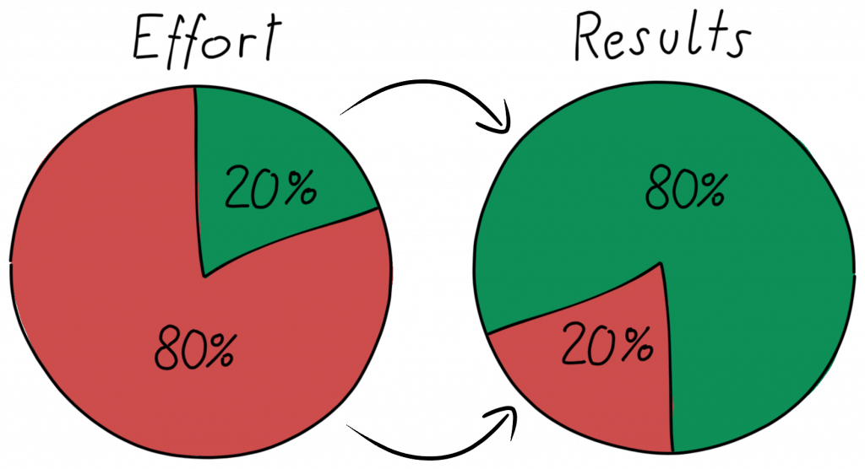
Pareto’s Principle
Although it is known that Zipf's law appears everywhere, it does not answer why it appears everywhere. There is not proven answer as to why it occurs, but there are many theories out there. A discrete form of Pareto's Principle is seen in graphs of Zipf's law. The Pareto Principle states that around 20 percent of the causes are responsible for 80 percent of the outcomes. Just like with Zipf's law, Pareto's Principle of Distribution is seen in many areas, but here are a few examples. In language, the most frequently used 18 percent of words account for 80 percent of all word occurrences.

Slide 53
Principle of Least Effort
There is one explanation that Zipf himself proposed, and that is the principle of least effort. The principle of least effort is a broad theory which suggests that animals, people, and even well-designed machines will naturally choose the path of least resistance or "effort". In the late 1940’s, Zipf studied this law. In that decade he published a book titled, “Human Behaviour and the Principle of Least Effort: An Introduction to Human Ecology”. He proposed that neither speakers nor hearers using a given language want to work any harder than necessary to reach understanding, and the process that results in approximately equal distribution of effort leads to the observed. He theorized that the distribution of word use was due to tendency to communicate efficiently with least effort, also known as Zipf’s law.

Slide 54
Probability of Chance
Some researches argue that for language, the explanation is even simpler than imagined. A few years after Zipf published his paper, Menort Mandelbert showed that there may be nothing mysterious about Zipf's law at all. If a person, or even in his experiment, a monkey, randomly typed on a keyboard, they will produce words distributed according to Zipf's law. The reason this happens is because there are exponentially more different long words than short words. If all 26 letters on a keyboard, including the space bar are equally likely to be typed, after a letter has been typed and a word has begun, the probability that the next input being typed is the space bar, is one in twenty seven. If someone randomly generates characters, about one in every 27 or 3.7 percent of the input between spaces, will be a single letter. Our mysterious distribution has been created out f nothing but the inevitabilities of math. Is language just as random as typing character in a keyboard.

Slide 55
Critical Points
Critical points may also play a role in the causation of Zipf's law. In writing and in conversation, speakers tend to stick to a topic. Even if, say in conversation, a person meanders off topic, there is still some type of segway that leads them in to the following thought. Speakers and writers have a reason to speak, and that's because they're saying something. Humans do not randomly choose words randomly. There is a union between their words. Conversations and literature aren't random. They have a purpose, so when a discussion is being had, they tend to repeat their point many times. The same vocabulary may show up repetitively, because that is what they are discussing. In literature, as well as in natural language, the topic of discussion is stuck with until a critical point is read. The critical point in a conversation is the moment when an agreement, conclusion, or turning point happens. Once the critical point of a conversation is reached, the subject is changed, and the vocabulary shifts. This is the way language flows. A topic is discussed, vocabulary specific to that topic is used, a critical point is met, and the subject changes. The critical point theory applies in small portions of text, but cannot apply in larger texts. Critcial points can be seen in short discussions, where the subject does not change, for at least a couple minutes. Paragraphs would also be a place where critical point theory could be used, because only one topic is discussed. However, once we look in to books, or even a chapter in a book, there is so much topic change that the main vocabulary for each topic does not stand out.

Slide 56
Preferential Attachment
Although randomness can explain a monkey receiving Zipf's distribution of text, that's not the way humans communicate. Language is deterministic, and carefully chosen. People don't just select unrelated words to follow after the next. What follows a sentence is the result of what was stated in the sentence before. Perhaps there is a way that thoughts and topics of discussion ebb and flow that contribute to Zipf's law. Maybe distributions occur through processes that chart change according to how they have previously operated. These are called preferential attachment processes. They occur when something is given out according to how much is already possessed. The more views a post gets, the more likely it is to be recommended to other individuals, which will attract even more views. Take a rolling snowball for example, the more the snowball rolls, the more snow it accumulates, expanding its surface area to collect more snow. The more snow that accumulates, the larger the surface area extends, the more snow a snowball can accumulated. Essentially, the big get bigger. There does not have to be a deliberate choice driving preferential attachment. It can happen naturally. This is seen in everyday life. Another note-able example, "The rich get richer", derives from preferential attachment processes. It's just math. Perhaps Zipf's law is, if not caused by, but at least strengthened by preferential attachment. Once a word is used, it is more likely to be used again.

